Slide 1
USPS
DIRECT MAIL
PROCESS
®
June 26, 2018

Slide 2
Introduction
The purpose of developing this training manual is to:
Introduce a standardized direct mail marketing process across all USPS marketing partners
Establish a process to drive all of the teams to function cohesively in order to improve the timing of deliverables
The training manual will provide a comprehensive overview of the direct mail (DM) process from the time a campaign is briefed, executed and completed. This will serve as both a USPS reference tool and a guide for all departments within MRM//McCann.
2

Slide 3
Step 1 - Project Kick Off/Pre-Briefing Phase
What is it: Prior to receiving the Client Brief, several meetings, discussions & research occur aimed at understanding what the need or “ask” is
Who’s the facilitator: USPS Business Driver
Who’s involved: USPS Business Driver, Account Management, Strategy, Analytics (potentially Creative if it involves brainstorming)
When does it occur: prior to any briefs being submitted to the Agency
Next steps: The Business Driver develops the brief
3

Slide 4
Step 2 – The Client Brief
What is it: An overview of the USPS Marketing Project requirements. Basic information needed:
Product Mix, Success Criteria, Campaign Objective/Reason for Mailing, Key Message, Call to Action (CTA)/ BRC, Target Audience (List Sources) and product mix
Budget (CPP), Test Plans, Mail Quantities, Desired In-Market Date, Format
Who’s the facilitator: USPS Business Driver
Who’s involved: USPS Business Driver, Account Management, Strategy
When does it occur: 60 calendar days (minimum) before the campaign’s in-market date
Next steps: Strategy documents the campaign details and presents it internally at MRM
4

Slide 5
Step 3 – Job Number
What is it: Job numbers are required to be opened so work can begin at the Agency
In order for a job number to be opened:
  Project needs to be in scope
  Campaign name/description must be standardized, unique and clearly identifies a specific campaign
  Should have: Fiscal Year/Qtr/USPS/Creative Name/Drop or Version number (if applicable)
  i.e. FY17 Q3 USPS “My Mail” DM
Note, Campaign Management has their own Job Number they use for the entire fiscal year
Who’s the facilitator: Project Management
Who’s involved: Project Management, Finance (Omaha)
When does it occur: After the client brief, completed within 1 business day
Next steps: Job number is distributed internally for all teams to use throughout the entire job
5

Slide 6
Step 4 – The Internal Agency Brief
What is it: The written strategy brief and goals from the client translated from the Client Brief by Strategy to inform the Agency of the project. The Internal (Springboard) Brief should also include reference to any past campaign performance/benchmarks/learnings to help guide the creative process
Who’s the facilitator: Account Management (on behalf of Strategy)
Who’s involved: Account Management, Strategy, Analytics, Creative, Production, Project Management, Marketing Operations
When does it occur: Within 5 business days from the client brief
Next steps: Project Management works with all the teams to create an internal schedule. Marketing Operations begins the list discovery process. Creative begins creative development. Typically, creative should have 2 weeks to develop their concepts
6

Slide 7
Step 5 – Campaign Schedules
What is it: A schedule from all departments with timing on key deliverables which all teams track against
Who’s the facilitator: Project Management
Who’s involved: Project Management, Account Management, Creative, Studio, Production, Marketing Operations
When does it occur: Starts after the internal brief, schedules are adjusted as needed
Next steps: The initial schedule and all subsequent revisions are submitted to all parties involved internally and externally
7

Slide 8
Step 6 – List Research
What is it: While creative concepts are being developed, the list exploratory is also being conducted. Campaign Management will reach out to the List Broker based off of the campaign target requirements and the Broker’s area of expertise. The List Broker will provide various list sources, available universes and pricing for primary & secondary target audiences. The List Exploratory and Target Audience Requirements form is required to be filled out completely and submitted to MOPS in order to begin the list research process
Who’s the facilitator: Marketing Operations (EK)
Who’s involved: Marketing Operations (EK), List Broker
When does it occur: Starts 1 business day after the internal brief and is completed within ~7-10 business days
Next steps: Research results are sent back to Marketing Operations from the List Broker for internal review
8

Slide 9
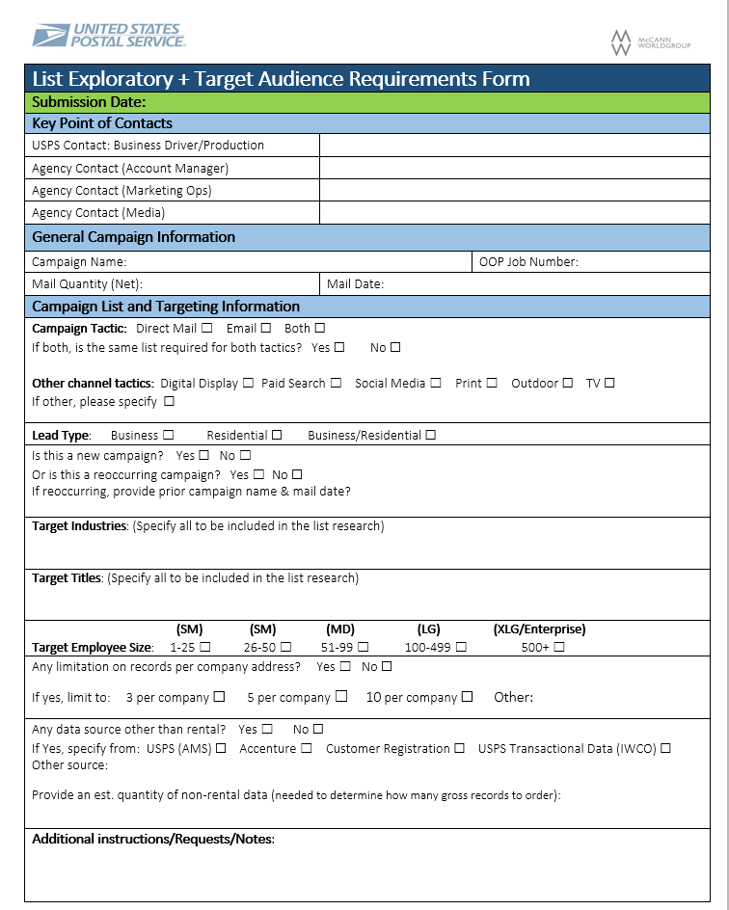
Sample List Exploratory and Target Audience Requirements Form
9

Slide 10
Step 7 – Creative Development
What is it: : Multiple creative concepts are developed at this time
Some of the things involved:
    Copy is being written
    Art work is being selected (if necessary)
    Creative layout and formats are being discussed
    Production must be involved to approve manufacturing and mailability of creative concepts
Who’s the facilitator: Creative
Who’s involved: Account Management, Project Management, Strategy, Creative and Production
When does it occur: Starts 1 business day after the internal briefing, completed in ~5-7 business days
Next steps: An internal review of the concepts is scheduled once the creative concepts are far enough along for review
10

Slide 11
Step 8 – List Exploratory (Internal Review)
What is it: The list information compiled from the list research from the List Brokers documenting all of the list information available by desired segments and the cost per thousand (CPM) pricing. This is reviewed internally against the requirements outlined in the client approved campaign brief
  Ex: number of records per company, employee size, industry type, titles, geographical, interests, etc…
Who’s the facilitator: Marketing Operations (EK)
Who’s involved: Marketing Operations (EK), Account Management
When does it occur: ~9-11 business days after list request was submitted
Next steps: The list exploratory, consideration set, recommendations and estimated costs are submitted to the client and a call is scheduled for discussion, feedback and approval
11

Slide 12
Step 9 – Creative Concept, Development & Internal Review
What is it: Multiple creative concepts are developed and reviewed by internal teams against the requirements outlined in the client approved campaign brief
Who’s the facilitator: Account Management, Project Management, Creative
Who’s involved: Account Management, Project Management, Creative, Strategy and Production
When does it occur: Starts ~8-9 business days after the internal briefing, completed in ~1-2 business days
Next steps: Creative may have to adjust their concepts based on the internal team’s feedback. Once concepts are finalized internally, the team presents creative concepts to the Client
12

Slide 13
Step 10 – Production Ball Park Estimate
What is it: Once the creative is selected, Production will provide “ballpark” pricing to be included for the client presentation.
Who’s the facilitator: Production, Account Management
Who’s involved: Production, Account Management
When does it occur: Requests are submitted ~3 business days after the internal brief and completed within 2 business days
Next steps: Production, Account Management provide final ballpark pricing and timing for each presented concept
13

Slide 14
Step 11 – Creative Concept, Client Presentation
What is it: Once, the creative concepts are reviewed and approved internally, the creatives are submitted to the clients. A meeting is set up for review and feedback. This step can involve several rounds of discussion and changes until the creative is finalized and approved. Usually, 2-3 creative concepts are presented to the Clients
Who’s the facilitator: Account Management
Who’s involved: Account Management, Creative, USPS Business Driver, Strategy, Production, Project Management
When does it occur: Begins ~2-3 business days after the internal creative concepts review. Creative is finalized ~5-10 business days after a creative has been selected by the Client
Next steps: Once the creative is approved, it goes into IPG legal
14

Slide 15
Step 12 – List Exploratory (Client Review and List Approval)
What is it: Marketing Operations and Account Management review the full list exploratory document with the client. The lists are discussed along with options, recommendations and OOP costs. Lists and quantities are selected and approved by the Client
Who’s the facilitator: Account Management, Marketing Operations (EK)
Who’s involved: Account Management, USPS Business Driver, Marketing Operations (EK)
When does it occur: ~2 weeks after the internal briefing
Next steps: Once the TPP is approved, lists are ordered
15

Slide 16
Sample List Exploratory
16

Slide 17
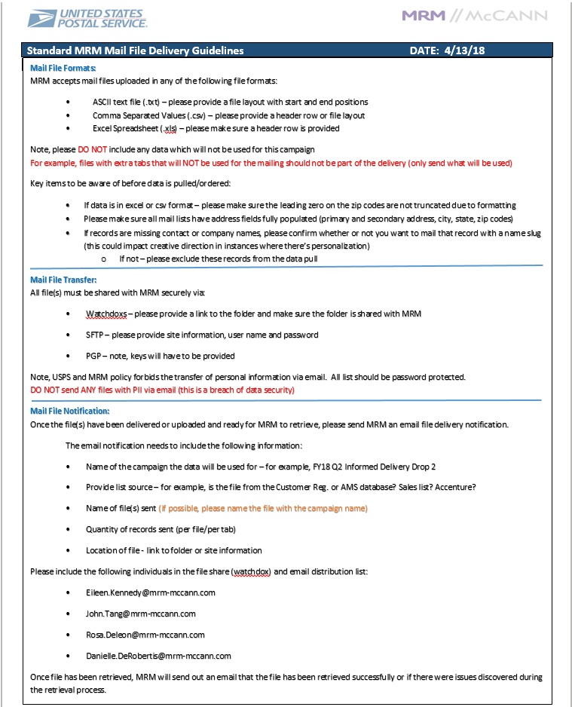
Step 13 – Client House or Non Rental Lists
What is it: Any lists sourced by USPS, not procured by MRM via List Brokers. For example: AMS, Cust Reg, Accenture, Sales files, etc…
A standard mail file delivery guide is available to help with requesting client files.
Who’s the facilitator: Account Management
Who’s involved: Account Management, USPS Business Driver
When does it occur: ~12 business days prior to when the lettershop/printer requires the data
Next steps: List sent via secured channels - SFTP, WatchDox or WebCargo to MRM for data hygiene
17

Slide 18
Step 14 – Campaign Matrix Development
What is it: The DM campaign matrix is a document used to map out key information for various execution groups. Information such as list source, target audience, seeds, counts, URLs, production and tracking codes (AM to develop with production), mail dates and in-market dates, product mix, etc. The matrix is utilized in conjunction with the DP/Lettershop specs sent to the data processing and Lettershop Vendors
Who’s the facilitator: Marketing Operations
Who’s involved: Account Management, Marketing Operations
When does it occur: Takes place ~2 weeks after the Agency brief, takes ~4-5 Business days to complete
Next steps: The completed matrix is circulated to all of the teams using the matrix
18

Slide 19
Step 15 – Campaign Matrix Development (Production Codes)
What is it: Production codes are assigned to each printed lot. The codes should be short, unique and representative of the creative lot.
Example:
  Job: Political Mail SM DM
    Local: PM6-18L
    State: PM6-18S
    Federal: PM6-18F
    APAC: PM6-18A
Who’s the facilitator: Account Management
Who’s involved: Account Management
When does it occur: at the time the matrix is developed
Next steps: The completed matrix is circulated to all of the teams using the matrix
19

Slide 20
Step 16 – USPS Marketing Database Set Up
What is it: From the matrix, Marketing Operations begins to create Campaign Identification Codes (Camp ID) and Marketing Activity Codes (MAC) for all DM campaigns. These are unique codes assigned to identify a specific DM campaign and their segments in the USPS Marketing Database. There is only one campaign ID, but one or various MAC ID’s can be created. Finder numbers and Version 3# can also be included, if requested. (reference the MOPS Database Training Guide – dated 6/12/18)
  Campaign ID = code used to identify a campaign, the overarching ID for the campaign
  MAC = code used to identify a segment within a campaign
  Finder # = a unique number assigned to a record, which identifies the record within a campaign/segment
Who’s the facilitator: Account Management, Marketing Operations
Who’s involved: Account Management, Marketing Operations, Database Vendor (IWCO)
When does it occur: Takes place ~2 weeks after the Agency brief, it takes approximately ~2 business days to generate and assign the codes
Next steps: These codes will be populated onto the campaign matrix and setup for tracking
20

Slide 21
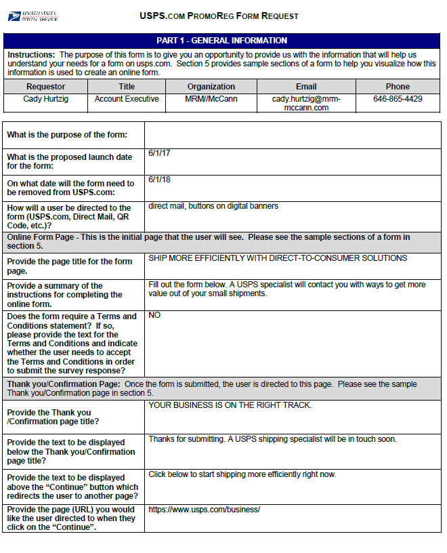
Step 17 – Promo Reg Page Creation
What is it: An Online Registration Page. Account management fills out all the required fields and the questions that will be detailed on the registration page/BRC. BRC & registration page should mirror each other, if they don’t then we require 2 Version 3#’s.
Who’s the facilitator: USPS, USPS Business Driver
Who’s involved: Account Management, Marketing Operations, USPS
When does it occur: Takes place simultaneously during matrix creation, and data processing. Creation/approval can take up to 7 business days.
Next steps: Request sheet is sent to USPS, USPS creates page and sends to marketing Operations for approval. Once approved we begin the parameter creation. At this time, the Agency submit the Version 3# request to the USPS.
21

Slide 22
Step 18 – Version 3#
What is it: A version 3# is a unique code assigned by USPS/Panorama to identify a specific campaign. It is the link between our internal campaign ID and USPS campaign ID. The version 3# is only requested when there is a BRC associated with the campaign or a promotion registration page. The AM team will need to communicate to the USPS Business Driver, that a Version 3# needs to be requested from Panorama and provided back to the agency. This will align results and tracking between the Agency and the USPS databases. This also help the USPS with identifying the right fulfillment package to the customers.
Who’s the facilitator: Account Management
Who’s involved: Account Management, Business Driver, Panorama, USPS
When does it occur: Takes place simultaneously during matrix creation, and data processing. Version 3# requests can take ~7 business days (or sometimes more)
Next steps: Upon version 3# request, and promo reg request, Marketing Operations can continue on to set up parameters for a specific campaign
22

Slide 23
Step 19 – Creative Concept Selected
What is it: USPS Business Drivers selects the creative. Account Management relays the “winner” to the internal teams and provides them with the creative concept. The creative concept can now be thoroughly reviewed by production and studio to plan how the creative will be produced.
Who’s the facilitator: Account Management
Who’s involved: Account Management, USPS Business Driver
When does it occur: Concepts are finalized ~5-10 business days from when the creative was presented to the Client
Next steps: Creative concept goes into the legal review process
23

Slide 24
Step 20 – Data Alignment & Requirement Call (DARC)
What is it: While the lists are being ordered, Account Management sets up a call with the Clients to discuss all of the data requirements and critical data dates for the DM campaign – i.e. types of data (rental, house, business, consumer), product mix, record quantities, personalization, capping, suppressions, data appends and tracking requirements
Who’s the facilitator: Account Management
Who’s involved: Account Management, Marketing Operations, USPS Business Driver, Production
When does it occur: Takes place ~3 weeks after the Agency brief, usually it takes ~30 minutes to review/discuss
Next steps: Once all of the data elements have been reviewed/discussed a final approved copy of the DARC document will be issued to all parties on the call and data processing will commence
24

Slide 25
Sample DARC Document
25

Slide 26
Step 21 – Legal Review (Agency)
What is it: Once the creative concept has been selected, Account Management submits PDFs of the creative to the IPG Legal Team to ensure the creative is in legal compliance.
Who’s the facilitator: Account Management
Who’s involved: Account Management, Agency Legal (IPG)
When does it occur: After the creative concept has been selected by the client. This step takes ~5-10 business days for legal to complete their review process.
Next steps: Creative is submitted to USPS Legal for review.
26

Slide 27
Step 22 – Legal Review (USPS)
What is it: Once the creative is approved by IPG Legal, the PDF concept is submitted to the USPS Legal Team to ensure the creative is in legal compliance.
Who’s the facilitator: Account Management
Who’s involved: Account Management, USPS Legal
When does it occur: Within 1 business day after the creative has been approved by IPG Legal. It takes ~6 business days for USPS Legal to complete their review process (5 days for review and 1 day for revisions).
Next steps: Once approved by Legal, the creative is submitted to Production
27

Slide 28
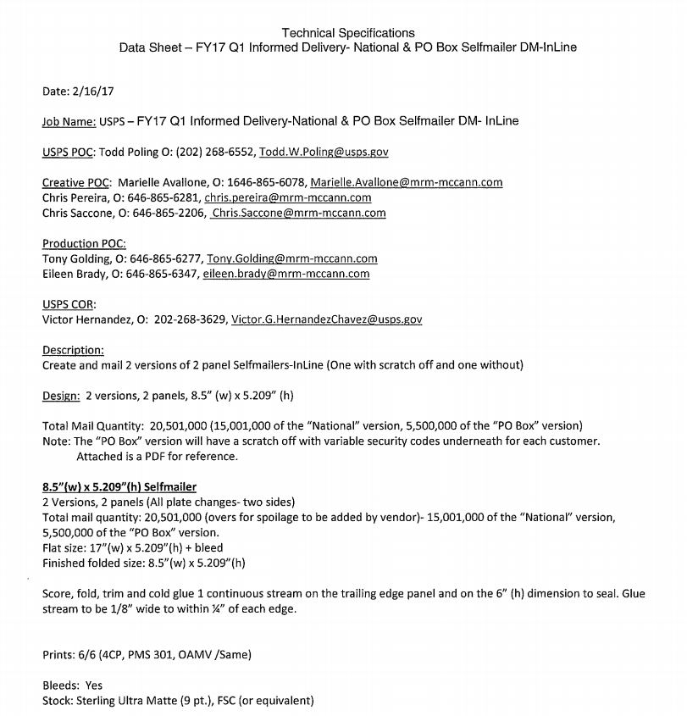
Step 23 – Production Spec Meeting
What is it: The meeting to obtain all the detailed specifications of the Client-chosen concept
Who is the facilitator: Project Management
Who attends: Project Management, Account Management, Creative and Production
What is needed: Initial matrix and version knowledge with creative layouts and color breaks
When does it occur: ~24–48 hours after the Client has chosen a final concept
Next steps: Production creates specs in order to provide them at the Pre-Pro and to obtain formal pricing from the USPS Contracting team
28

Slide 29
Step 24 – USPS Procurement
What is it: The project bidding and awarding process at USPS. Completed specs and a PDF of the approved creative is sent to USPS Marketing Services/Contracting who bids the job out to suppliers.
Who’s the facilitator: Production
Who’s involved: USPS Contracting Officer Representative, USPS Procurement
When does it occur: ~2 business days after Spec Meeting
Next steps: Procurement notifies Production ~10 business days of awarded Supplier(s).
Note, if the Agency is handling the procurement, they also triple bid the project
29

Slide 30
Step 25 – Production Technical Price Proposal (TPP)
What is it: Once the Production estimates are submitted (studio, travel, any production related expenses) to the Account Management team, the Account Management team creates a TPP and submits it to contracting for approval. Once the TPP is approved and a funding notification is provided, work can begin.
Note, the TPP is generated by the USPS if they are managing the production
Who’s the facilitator: Account Management
Who’s involved: Account Management, USPS Contracting Officer Representative (COR)
When does it occur: Takes place 1 business day after estimates are submitted. ~2-3 days is required for the TPP to be approved by USPS COR.
Next steps: Once the TPP is approved and a funding notification is provided, work can begin
30

Slide 31
Step 26 – List Rental Technical Price Proposal (TPP)
What is it: Once lists are selected and approved by the Client, a TPP is drafted and submitted along with the back-up documentation to the Agency Contracting team for review; then submitted to the USPS COR for approval. TPP’s are required documents used to request funding for a DM campaign so that rental lists can be secured
Who’s the facilitator: Account Management
Who’s involved: Account Management, Marketing Operations (EK), USPS Business Driver
When does it occur: 1 business day after lists are selected. ~2-3 business days to complete the review and approval process.
Next steps: Once the TPP is approved and a funding notification is provided, the rental lists are ordered
31

Slide 32
Step 27 – Rental List Ordering
What is it: Upon receiving TPP approval from the COR, the Marketing Operations team will order the rental lists. Marketing Operations will submit a purchase order to the List Broker. The List Broker will execute the orders and files will be delivered to the data processing Vendor’s SFTP site.
Who’s the facilitator: Marketing Operations (EK)
Who’s involved: Marketing Operations (EK)
When does it occur: Starts within 1 business day after the TPP is approved. ~3-5 business days later, the lists will be delivered to the data processing Vendor.
Next steps: Lists are retrieved by the data processing vendor and a quality control process is underway to check for any data issues like off counts, file compression issues, missing fields, etc.
32

Slide 33
Step 28 – Data Processing (Phase 1)
What is it: Once the data processing vendor has all files and the funding notification is in place, the data processing begins
First week of processing:
  DP Specs and matrices are submitted to the Vendor
  Standardization – data files are converted into a standard/unified format so that the various files can be data process together
  Hygiene – data is cleansed to remove profanity, decease customers, prison addresses, vacant and bad addresses
  Merge-purge – to remove duplicate records
  Suppressions – USPS addresses, Compliance (Opt-outs and DNS), natural disaster, any other records deemed non applicable or no longer qualifying
  NCOA – data is run against the USPS National Change of Address database to update the addresses of the customers who have recently moved
  Waterfall – a breakdown of the starting quantities, the drops and the mailable records
Who’s the facilitator: Marketing Operations
Who’s involved: Marketing Operations, Data Processing Vendor (Cross Country Computer)
When does it occur: Starts within 1 business day after the files are delivered, ~10 business days for the data processing to be completed
Next steps: Waterfall report to client for approvals
33

Slide 34
Sample Data Processing Spec and DM Matrix
DP Specs
DM Campaign Matrix
34

Slide 35
Sample Waterfall Report
35

Slide 36
Step 29 – The Pre-Production Meeting
What is it: The “Pre-Pro” is a meeting for the final review of the Client approved copy and layout in order to place the job into the Studio. The spec sheets, creative layouts, color breaks, Art Director paths, version information, studio estimate and art for retouching (if needed) are reviewed.
Who’s the facilitator: Project Management
Who’s involved: Account Management, Project Management, Creative, Production, Studio
When does it occur: Starts 1-2 business days after approval of Studio TPP
Next steps: Studio creates the 1st round mechanicals, color breaks and folding comps
36

Slide 37
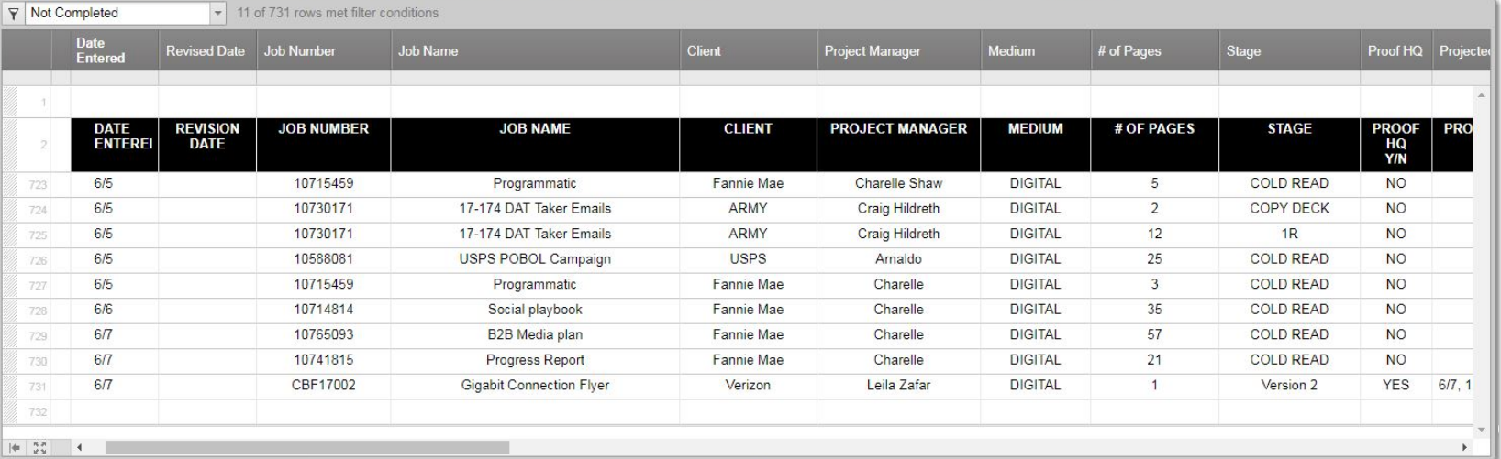
Sample Proof Reading Hot Sheet
What is it: All jobs entering proofreading must be entered on the proofreading hot sheet in Smart sheet at least 3 days prior to allow for the scheduling of proper coverage
Who’s the facilitator: Project Management, Account Management
Who’s involved: Account Management, Project Management, Proof Reading, Production
When does it occur: Starts 1-2 business days after approval of Production TPP
Next Steps: Mechanical rounds
37

Slide 38
Step 30 – Database Setup and Matrix - Final Stage
What is it: By the time the waterfall is approved, Account Management should have finalized all of the seeds, version codes (version 3#), and URL’s. Vanity URL’s should be approved by Legal at this point. Once they are approved by Legal, parameter creation begins.
  Provide Marketing Operations with the Masterfile that includes all MAC code requests.
  Parameters are created by Marketing Operations, sent to USPS for review and approval, then Google Tested to make sure the tracking is working properly
  Creation, approval and Google Testing can take ~3-5 days
Who’s the facilitator: Marketing Operations
Who’s involved: Marketing Operations & Account Management
When does it occur: As soon as URLs are approved by legal, and the Root URL/Destination is finalized. Creation of parameters, approval and Google Testing can take ~3-5 days
Next steps: Vanity URL Creation. Once parameters are approved and ready to go, Account Management fills out the Vanity URL Review and Approval Form. Marketing Operations then sends over approved parameters to USPS for vanity URL creation
38

Slide 39
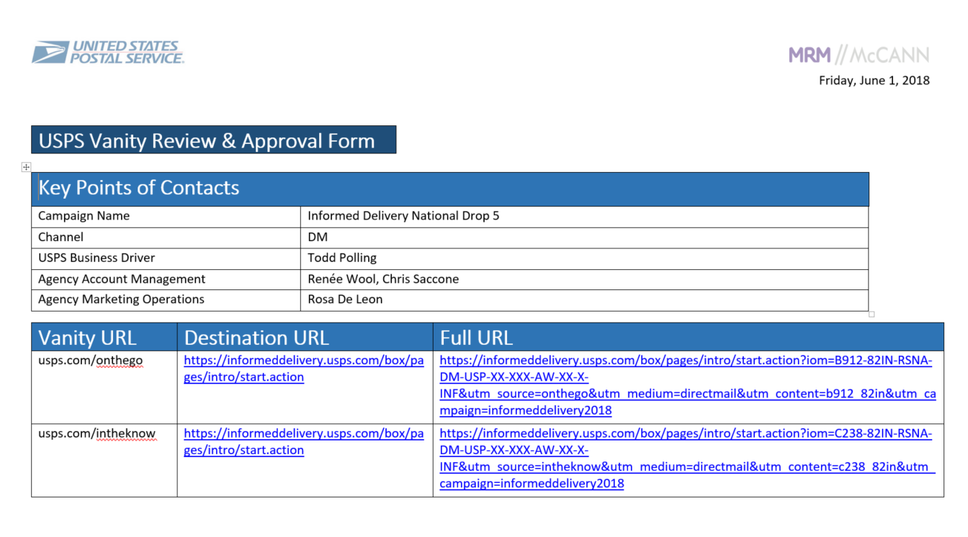
Step 30a – Database Setup and Matrix - Final Stage – Vanity URL Form
What is it: The Vanity URL Review and Approval Form is used to confirm that all the Vanity URL destinations are correct and the parameters are also set up. Account Management completes the Vanity Review and Approval Form and sends to Marketing Operations. Marketing Operations then sends the form to USPS for vanity creation. Once vanities have been created and set up, Marketing Operations sends to Account Management for review and client approval
Who’s the facilitator: Marketing Operations
Who’s involved: Marketing Operations & Account Management
When does it occur: As soon as parameters have been tested and are ready to implement
Next steps: Waterfall Report
39

Slide 40
Step 31 – Data Processing (Phase 2)
What is it: Once the waterfall report is approved by USPS, seeds are checked and provided to MOPS, along with final matrix. Phase 2 data processing begins and the mail lists are finalized
Final week of processing:
  Name, Company Name slugging – records where the name and company name fields are blank, “fillers” are appended. For USPS, Postal Customer is appended as the customer’s name & Current Business is appended as the company name
  Upper/Lower Casing – the names, company names and addresses are formatted with upper casing on the first letter of each word and lower casing on the letters following
  Data Segmentation – if requested, data can be split into multiple outputs
  Data Appends – seeds, tracking IDs, version codes, vanity URLs, Version 3#, etc.…
  Quality Assurance and Reporting – data goes through various quality control; throughout the process. A final check and reports will be issued at the end of the processing run for internal approval, before data is posted and released to the Lettershop
  Mail File Delivery Notification – an email notification detailing the file name, counts, number of files, SFTP, passwords and file location will be sent to the production and/or lettershop POC. File support documentation will also be sent: file layout, record dumps, NCOA/CASS report, seed file and matrix
  Opt-out compliance: Lettershop must drop mail 30 calendar days from when the files are posted
Who’s the facilitator: Marketing Operations
Who’s involved: Marketing Operations, Data Processing Vendor (Cross Country Computer)
When does it occur: Starts after waterfall approval, completed ~3-5 business days
Next steps: Data processing completed and files are ready for Lettershop retrieval
40

Slide 41
Step 32 – The Release
What is it: The approved files are transferred to the production vendor via WebCargo. A copy of the Mechanical Release Form is provided by Production.
It includes for reference:
  PDFs
  Color breaks
  File Location
  Layered InDesign file
  Mechanical Release Form
Studio notifies internal team of the file posting. Account provides 2 hardcopies of the mechanicals and color break to Production. Production then follows up with the Vendor.
Who’s the facilitator: Production/Studio
Who’s involved: Account Management, Production, Project Management, Studio
When does it occur: Starts upon Client approval of final mechanicals. The entire mechanical release process takes ~3-4 hours, depending on the job complexity
Next steps: Production prepares lettershop instructions to send to the vendor. Vendor produce proofs and lives
41

Slide 42
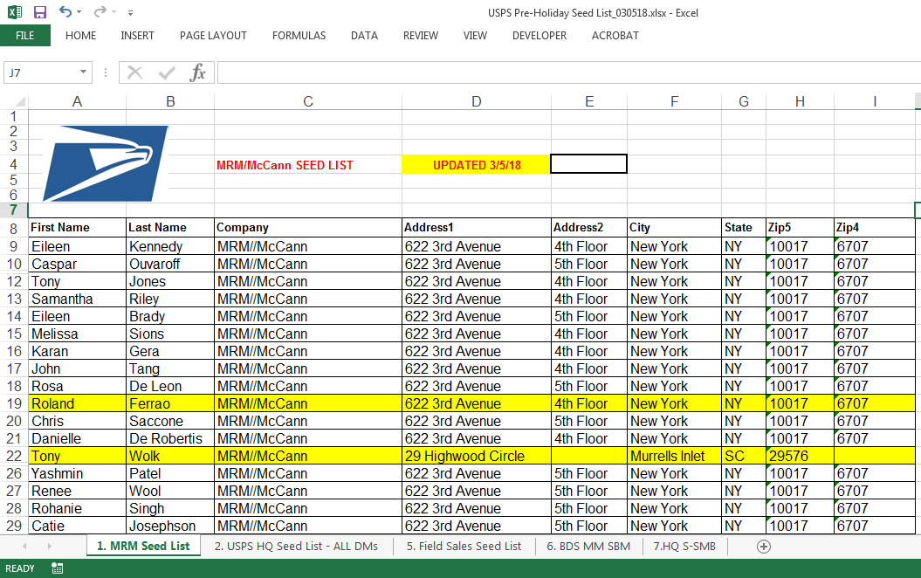
Step 31b – Data Processing (Phase 2)
Key items to know:
  Seed Lists
    checked by Account Management to make sure seeds are up to date
    only send MOPs the relevant tabs being used, delete tabs not used to eliminate confusion
  Matrix
    finalized and checked before submitting to MOPs
    Check drop dates, if there are multiple drop dates
    URLs are checked
    Check all versions are accounted for
42

Slide 43
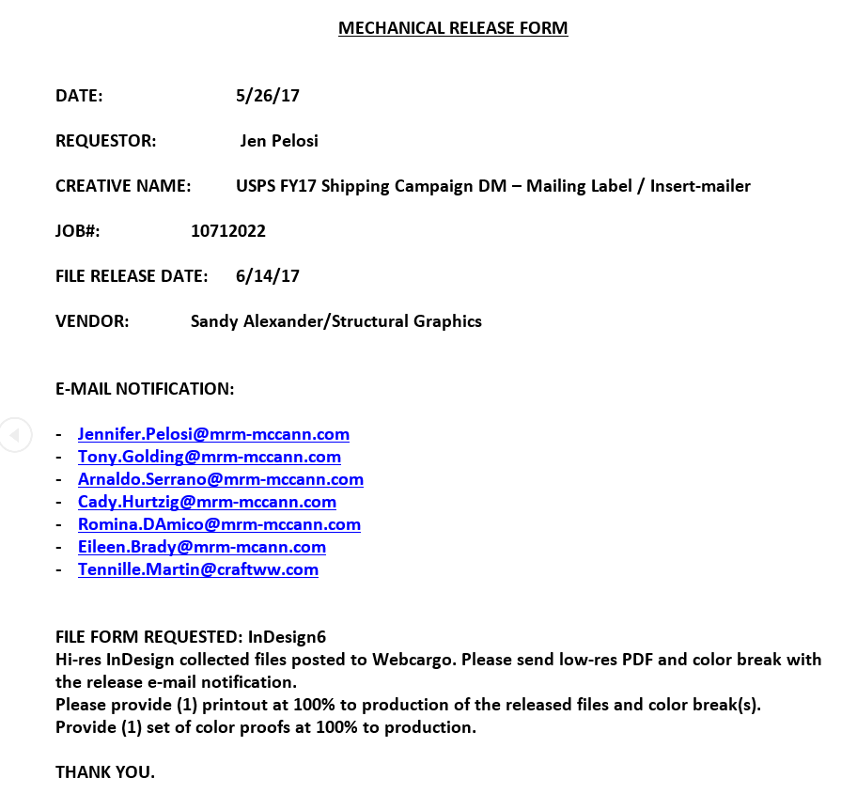
Sample - The Mechanical Release Form (MRF)
43

Slide 44
Step 33 – The Routing Process
What is it: Once Production receives proofs/lives from the vendor, they are routed through the Agency as well to the Client for approval. Production reviews and creates a routing cover sheet before giving the proofs to Account/Project Management. Account/Project Management stamps each proof and places them into the job jacket. The job jacket is routed to each department for their review and approval.
Who’s the facilitator: Production, Account Management, Project Management
What’s involved:
  Pre-printed Proofs: Production, Account, Proofreading, Creative and Client
  Live Sign-Off: Production, Account, Proofreading, and Client
    *Please note, if the lives only have the mailing address, Proofreading is removed from this cycle
  Mail OK’s: Production, Account and Client
When does it occur: when proof/lives are received
Next steps: The stamped, signed and approved proofs are copied 2x by Account/Project Management. The originals and one set of copies are given to Production. The remaining set is kept in the job jacket with the routing cover sheet. Printing begins
44

Slide 45
Sample - Routing Cover sheet
45

Slide 46
Step 34 – Accums (Counts) Approval
What is it: The Accums approval step is a simple but critical quality control check to ensure data received by the Lettershop is in alignment with the quantity delivered. These reports detail the counts prior to and after presort, to ensure that none of the records have dropped out during the presorting processing. The Accums are reviewed and approved by Production, Account Management, Marketing Operations and the Client.
  The Accums are generally requested as follows:
    Campaign code
    MAC codes
    Version counts
    State counts (if necessary)
    Package Code
Who’s the facilitator: Lettershop, Production
Who’s involved: Lettershop, Production, Account Management, Marketing Operations, USPS
When does it occur: ~2 business days after data is delivered to the Lettershop
Next steps: Lettershop goes into production and begins the process of merging the data with the creative
46

Slide 47
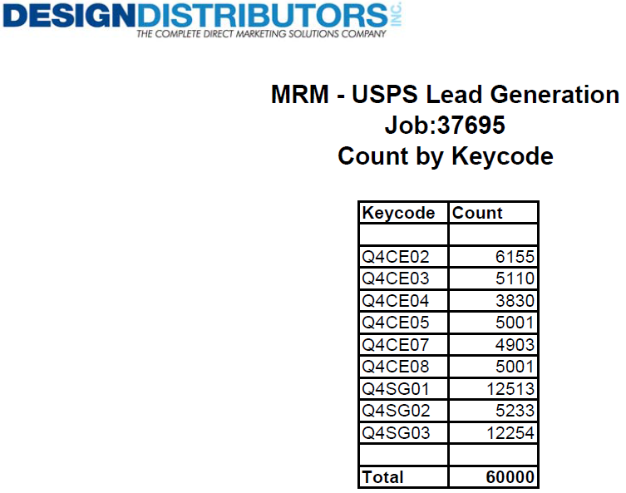
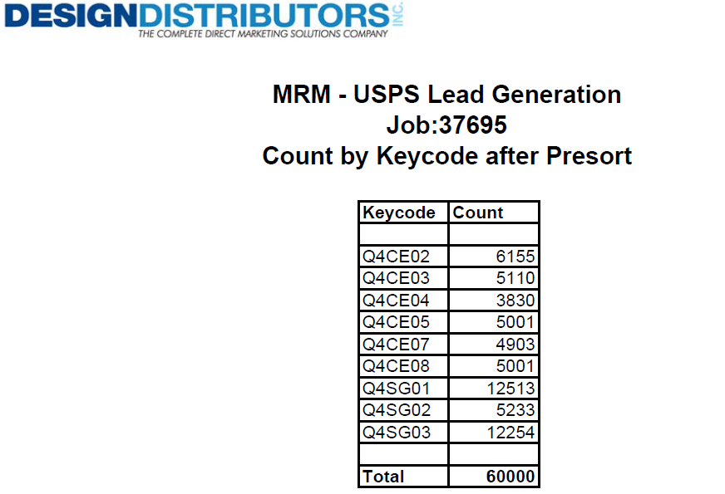


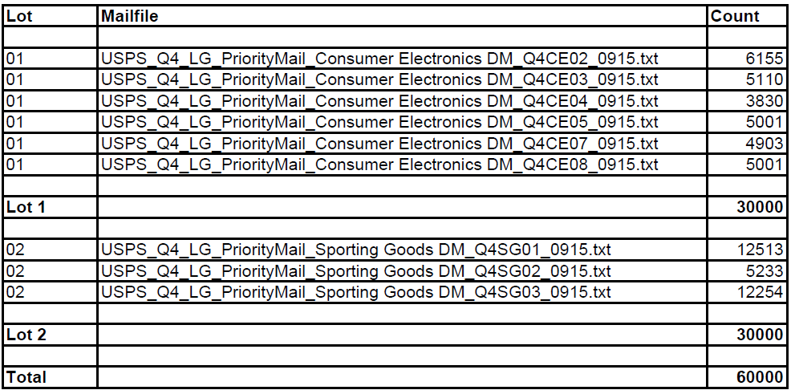
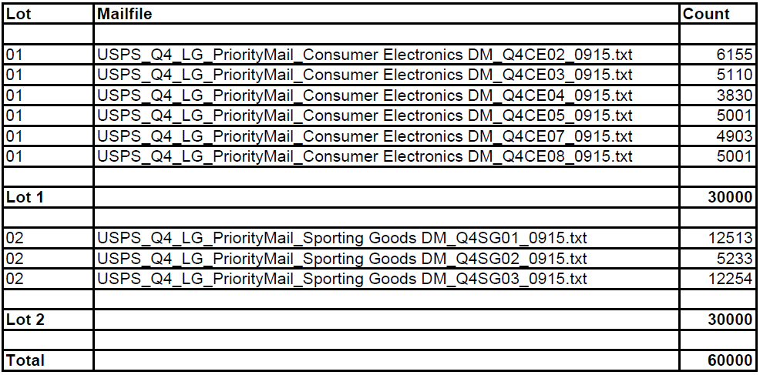
Sample Accums Report
Counts Prior to Pre-Sort
Counts Post Pre-Sort
47

Slide 48
Step 35 – Lives (Data Dumps and Layouts)
What is it: This is a critical quality control checkpoint to ensure the data is imaged onto the creative correctly. Account Management, Production and the Client will utilize the data dumps and file layout to check the Lives.
A data dump is a visual representation of the selected data for imaging. Input dumps show the raw data as it has been provided to the Lettershop from the data vendor. Output dumps show the data after it has been converted by the Lettershop. These reports are used to check the accuracy of Lives.
  A record layout is a guide used to identify the location of specific data within the data dump. A data dump cannot be reviewed without a record layout. A record layout is necessary to locate the position of the data fields. The Live is sent via PDF and hard copy for approval by the Agency and the Client. ~24 hours is required for approval
Who’s the facilitator: Lettershop, Production
Who’s involved: Lettershop, Production, Account Management, Proof Reading and USPS
When does it occur: ~2 business days after accums are approved
Next steps: The job is now approved for imaging
48

Slide 49
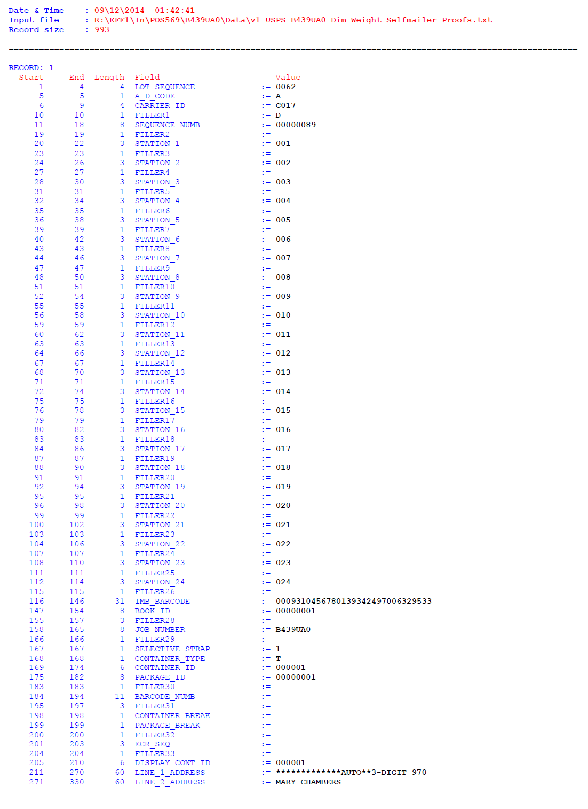
Sample Data Dump and File Layout
49

Slide 50
Step 36 – Mail OK’s
What is it: A completed mail piece that has been pulled by the Lettershop, at random, from the mail trays of a completed job. This is the FINAL checkpoint by the Agency and the Client before the mail enters the mail stream. Hard copies are sent to the Client and Agency. Account Management, Production and the Client are required to approve the Mail OK’s before the lettershop can begin the mail drop.
Who’s the facilitator: Lettershop, Production
Who’s involved: Account Management, Production, Client
When does it occur: ~2 business days prior to mail drop
Next steps: Upon Client approval, mail is presented to the USPS for mail induction
50

Slide 51
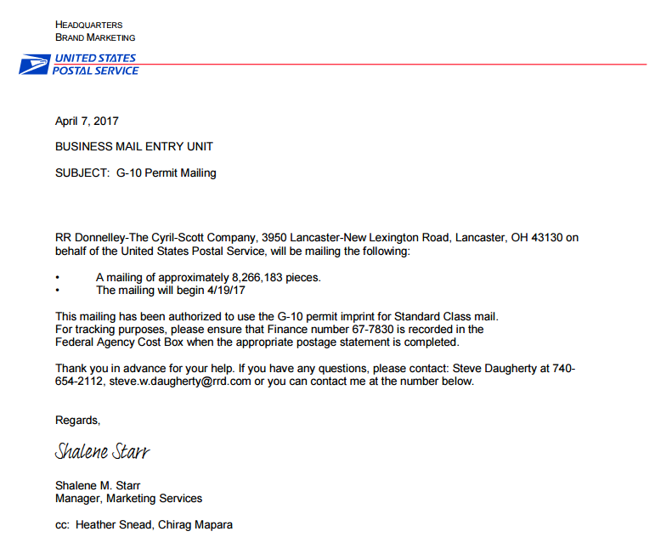
Step 37 – G10 Permit Authorization
What is it: An authorization letter from the USPS to the local USPS agent, to mail the job under the G10 permit
Who’s the facilitator: Production
Who’s involved: Account Management, Production, USPS
When does it occur: ~5 business days prior to mail drop
Next steps: mail drop
51

Slide 52
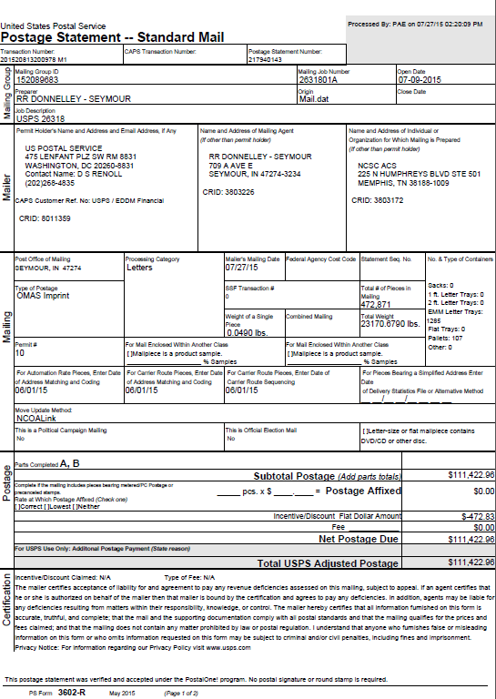
Step 38 – Mail Drop and Postal Receipts
What is it: A postal receipt verifying that the mail has been presented to the USPS. It shows the date, class, sortation and cost of each mail drop. Production reviews the documents, forwards to Account Management, who then forwards to USPS
Who’s the facilitator: Production
Who’s involved: Account Management, Production, Client
When does it occur: Mail drops within 1 business day of Mail OK’s approval and postal receipts (3602s) are provided 24 hours after mail drops
Next steps: Mail tracking
52

Slide 53
Step 39 – Mail Tracking
What is it: Daily report that reads the IMb (Intelligent Mail Bar Code) as it travels through the mail stream
Who’s the facilitator: Lettershop
Who’s involved: Lettershop, Production, Account Management, USPS
When does it occur: Starts a day after mail drops
Next steps: Campaign reporting
53

Slide 54
Step 40 – Campaign Tracking and Reporting
What is it: If reporting was requested at the start of the process, weekly campaign reports are created to detail nixies and campaign responses. Weekly reporting is generated for ~8 weeks following the mail drop, once the responses starts coming in. Weekly campaign reports are issued every Thursday.
A DM Campaign dashboard is also produced and issued to USPS every quarter.
Who’s the facilitator: Analytics,
Who’s involved: Analytics, Account Management, USPS
When does it occur: Starts ~2 weeks after mail drops and goes for ~8 weeks
Next steps: Job completion
54

Slide 55
Step 41 – Job Completion
What is it: The reconciliation of all the Out Of Pocket costs (OOP) for each individual campaign
Who’s the facilitator: Production, Account Mgmt., Marketing Operations
Who’s involved: Accounts Payable, Production, Account Mgmt., Marketing Operations
When does it occur: All jobs must be closed within 90 days of the final mail/delivery date
Next steps: Invoices are submitted to USPS on a monthly basis. Invoices are processed ~24- 48 hours of receipt. Checks are cut by Accounts Payable and Vendors are paid within ~60 days.
55

Slide 56
GLOSSARY

Slide 57
Capping – to place a limit or restriction on the mailing list
Coding Accuracy Support System (CASS) – CASS certification is offered to mailers, service bureaus and software vendors that would like the USPS to evaluate the quality of their address-matching software and improve the accuracy of their ZIP+4, carrier route and 5 digit coding.
Data Hygiene – a collective process conducted to ensure the cleanliness of data. Data is considered clean if it is relatively error-free. Dirty data can be caused by a number of factors – including duplicate records, incomplete or outdated data and improper parsing of record fields from the disparate systems.
Marketing Activity Codes (MAC) – MACs are assigned to segmented data to track responses, codes are unique to each segment.
Merge Purge – process of identifying and eliminating duplicate names within and among a number if mailing lists selected for a given direct marketing campaign.
National Change of Address (NCOA) – Process where mail lists are updated with recent mover information
Nth Select – Process that extracts a sample of names from a mailing list by applying random selection to end up with the desired quantity.
57

Slide 58
Seeds/Seed List - a technique used by companies conducting direct mail programs to monitor the delivery time of mailed campaigns. Also, allows the List Brokers to monitor how authorized partners are using their rental lists
Color breaks - In multicolor printing, this is a document that points out the many separations of colors and varnishes that need to be indicated for the print supplier. Both Production and Creative must approve this document.
FOF - Fixed on file. A change that is not reflected on the “physical” reader, but has been made on the digital file .
Imaging - The personalization of static copy, variable copy, and simple graphics by using either toner or ink-based techniques (lasering, ink-jet, etc.). It is done by the Lettershop to each individual mail piece.
Leading and Kerning - Leading - (ledding) The amount of vertical space between lines of type. Kerning: The adjustment of space between letters.
Lettershop - A Supplier that performs the processes necessary to complete a direct mail project. Some of the processes are data conversion, imaging, folding, labeling, sealing, stamping, and inserting. The Lettershop delivers the completed pieces to the USPS for mailing.
58

Slide 59
Mailing Lot - A grouping of cells from the matrix that share “like” components (e.g., LH, OE, CLU) to create efficiencies at the Lettershop. Once cells are grouped into a mail lot, they cannot be separated without reprocessing the data at the Lettershop.
Mechanicals - layout, copy, and artwork, routed internally and sent to the Client for approval.
NRB (Non-Repo Blue) - Light blue color used to designate lettercopy that will be imaged (lasered/inkjet) on a direct mail piece.
Printer - A Supplier that produces a wide range of products such as letterhead, envelopes, brochures, booklets, and magazines. This is done by reproducing text and image, typically with ink on paper using a printing press and a variety of finishing techniques.
Printer Errors (PEs) and Author Alterations (AAs) - PEs - Edits that must be made due to Printer/Agency error(s). AAs: Client revisions after proofs have been received.
59

Slide 60
Secure File Transfer Protocol (SFTP) - A common method of moving files between two Internet sites that allows a user to log in, via password, to another Internet site for the purposes of retrieving and/or sending files. This is a secure site as opposed to a regular FTP.
Studio Comps/ Folding Dummies - Commonly referred to as “comp” is a mock-up of a creative. Note: Comps are created in the 1st Round of a project and at the Release Round. This is done to confirm that the project is still in the correct size and that the work/design is functional. The “tap” test is also performed at this time to ensure the address block fits the window on the OE.
Variable Copy - Imaged copy that changes from one mail piece to the next within the same imaging run. The variable information can be pulled directly from the mail file or the final matrix.
60

Slide 61
THANK YOU!

